Slide 1
Circle Ci
Presented By: Susil Rayaguru

Slide 2
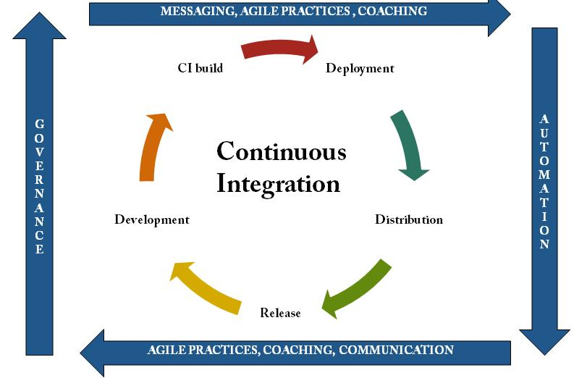
What is Continues Integration

Slide 3
Continuous Integration Process: In simple terms, when a developer incorporate any changes to code, he needs to do certain process afterwards so that the code can he shipped to client.
Abstract steps to be carried on….
Make changes to code.
Test the code. //locally
Push to code to some Version controlling System //tortoise or GitHub
Prepare the Build //war or jar or ear
Deploy the component to server.
Note: I’ve waived out few subtle steps too….. ;)
And Now a days we all follow Agile model hence, we have frequent releases, possibly once or twice in a week. The developer need to follows all these tedious task repeatedly.
This turn out to be a vicious circle, which keeps iterating over and over…

Slide 4
What could be the solution to such a tedious task.
- Automation of the process using Continues Integration tools like
Codeship, CircleCI, Bamboo, Teamcity and Jenkins to name a few.
Each of these tool has got ít’s pros and cons and it come down to personal choice to pick any one.
Here we’ll be justifying Circle Ci.

Slide 5
What we can achieve with Circle Ci
We can configure Github repo with circle ci.
When code is pushed to Github ,Circle Ci will be notified, it creates the required environment for our code to be tested based on our code or you can specify a specific environment with a configuration file named as Circle.yml. Here environment means version of JDK, Database type and other services as well.
It automatically infers your settings from your code and execute test cases to create a build accordingly.
Circle ci is integrated with AWS. Hence it can deploy the build to Amazon EC2 instances using ECS (EC2 Container Service).
It has got very powerful server where you code can be tested very fast.

Slide 6
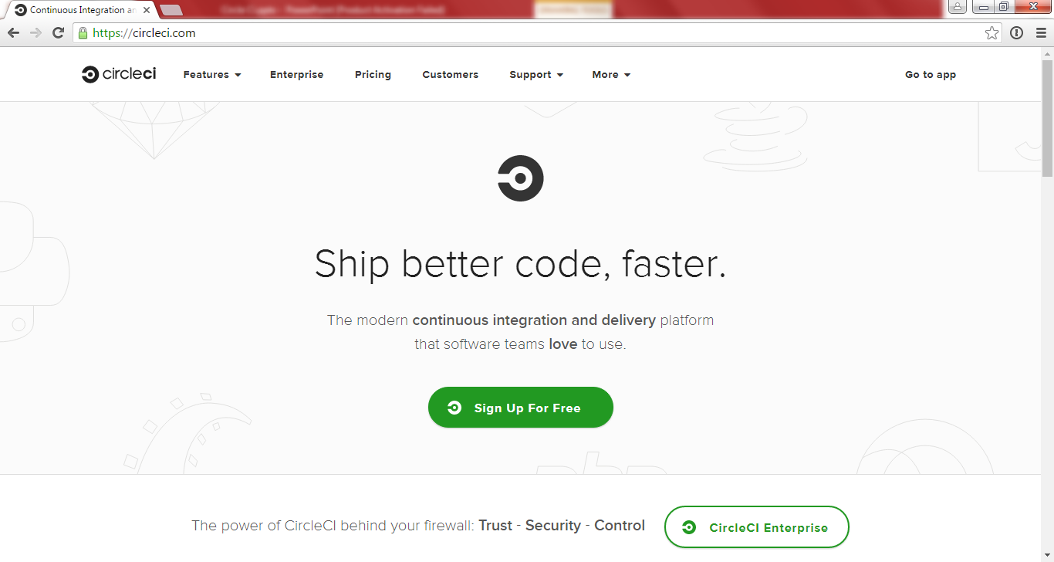
Circle Ci Integration
Access Cirle Ci and do the free sign up //though CircleCi is not a free Service ;)
Add your github project to circle ci as part of signup process
Afterwards CircleCI automatically infers your settings from your code and prepare the build while running our test cases.

Slide 7
Configuring Circle Ci for your project
While making a build of your project , circle ci prepare the required environment stack i.e os, software packages, database etc.
To configure Circle Ci environment, we need to define the configuration in circle.yml file.
Structure of circle.yml file
It has got six primary segments as
machine: adjusting the VM to your preferences and requirements
checkout: checking out and cloning your git repo
dependencies: setting up your project’s language-specific dependencies
database: preparing the databases for your tests
test: running your tests
deployment: deploying your code to your web servers

Slide 8
You can modify which—and when—commands are run by adding override, pre and/or post to adjust CircleCI’s inferred commands. Here’s how it works:
• pre: commands run before CircleCI’s inferred commands
• override: commands run instead of CircleCI’s inferred commands
• post: commands run after CircleCI’s inferred commands

Slide 9
Sample circle.yml file
machine:
version: oraclejdk8
services:
- postgresql
machine:
pre:
- date
- pwd
version: oraclejdk8
services:
- postgresql
test:
pre:
#can specify some valid linux script #or command here
override:
-mvn clean install
database:
override:
#- creates a super user (-s) who #-can create database (-d);
- createuser -s -d testuser
#- create a database
- createdb testdb

Slide 10
Environment variables
Circle ci creates a bunch pre-defined environment variable that you might find handy for your build process.
CIRCLE_BRANCH: The name of the Git branch being tested, e.g. ‘master’, if the build is running for a branch.
CIRCLE_REPOSITORY_URL: A link to the homepage for the current repository, for example, https://github.com/circleci/frontend.
CIRCLE_USERNAME: The GitHub login of the user who either pushed the code to GitHub or triggered the build from the UI/API.
Note: To name a few, more you can refer online documentation
https://circleci.com/docs/getting-started/

Slide 11
SSH to Circle Ci
Circle Ci gives seamless access to the running environment using ssh , so that you can access it and probe it for any good reason.
Few points to be considered before doing a ssh.
In Github you can create any no of public keys and push the code. Public key will be stored or copied to github and private key will be kept at the client side.
Circle Ci uses the same ssh key that is used with github.
After enabling ssh in Circle Ci it keep the box up and running for 30 min only.
More Info can be found at https://circleci.com/docs/ssh-build/

Slide 12
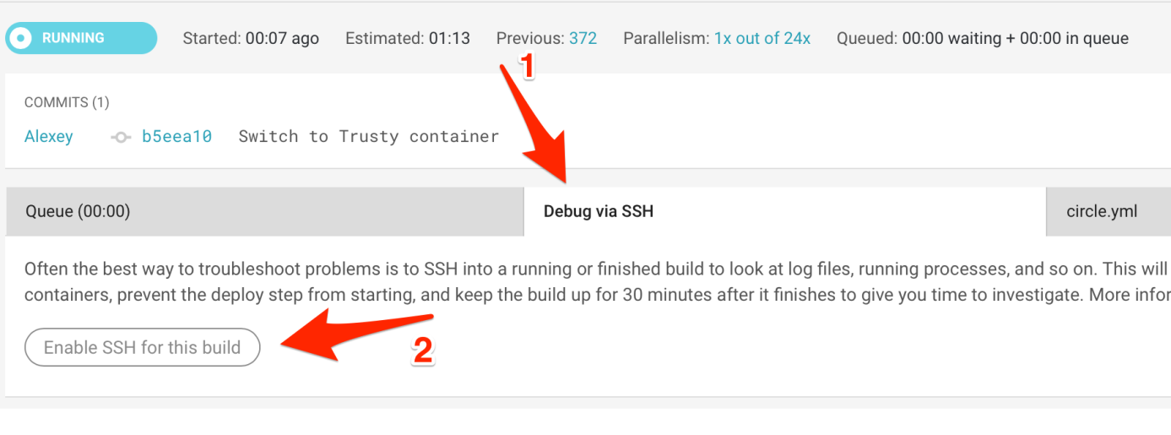
Enabling SSH
To enable SSH access for a running build, go to the ‘Debug via SSH’ tab and click the ‘Enable SSH for this build’ button.

Slide 13
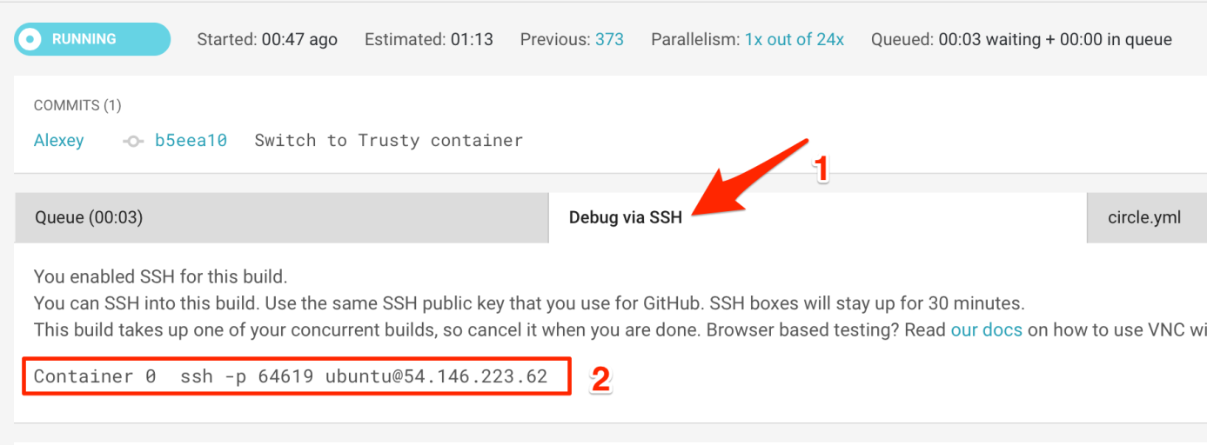

Slide 14
Steps
Login in to any of your linux box.
ssh-keygen -C <email id> //press enter
Enter file in which to save the key (/home/ubuntu/.ssh/id_rsa): //press enter
It will ask for the pass phrase //enter the pass phrase
Once you done with above steps, it generates two files in home/ubuntu/.ssh/id_rsa directory, ofter the file with .pub extension and copy the text present in it.
Log into your github account , go to settings , select ssh and gpg keys, and click new ssh keys and provide any title and paste content of .pub to the key field.
Now test ssh with github using ssh git@github.com , it will ask passphrase and they will display as below
Hi cirlcitest! You've successfully authenticated, //circletest will be a diff one ;)
After doing above steps we’ll move to ssh with circle ci.

Slide 15
Thank You

